Slide 1

Graphical Analysis using R
Dr. Rakhee Chhibber

Slide 2

Plots in R
Basic Plotting,
Manipulating the plotting window
Box Whisker Plots
Scatter Plots
Pair Plots
Pie Charts
Bar Charts.

Slide 3
Introduction
Much of the statistical analysis is based on numerical techniques, such as confidence intervals, hypothesis testing, regression analysis, and so on. In many cases, these techniques are based on assumptions about the data being used. One way to determine if data confirm to these assumptions is the graphical data analysis with R, as a graph can provide many insights into the properties of the plotted dataset.
Graphs are useful for non-numerical data, such as colours, flavours, brand names, and more. When numerical measures are difficult or impossible to compute, graphs play an important role.

Slide 4

Types of plots drawn in R programming are
Plots with Single Variable – You can plot a graph for a single variable.
Plots with Two Variables – You can plot a graph with two variables.
Plots with Multiple Variables – You can plot a graph with multiple variables.
Special Plots – R has low and high-level graphics facilities.

Slide 5

Plots with Single Variable
You may need to plot for a single variable in graphical data analysis with R programming. For example – A plot showing daily sales values of a particular product over a period of time. You can also plot the time series for month by month sales.
The choice of plots is more restricted when you have just one variable to the plot. There are various plotting functions for single variables in R:
hist(y) – Histograms to show a frequency distribution.
plot(y) – We can obtain the values of y in a sequence with the help of the plot.
plot.ts(y) – Time-series plots.
pie(x) – Compositional plots like pie diagrams.

Slide 6

Types of plots available in R
Histograms – Used to display the mode, spread, and symmetry of a set of data.
Index Plots – Here, the plot takes a single argument. This kind of plot is especially useful for error checking.
Time Series Plots – When a period of time is complete, the time series plot can be used to join the dots in an ordered set of y values.
Pie Charts – Useful to illustrate the proportional makeup of a sample in presentations.

Slide 7
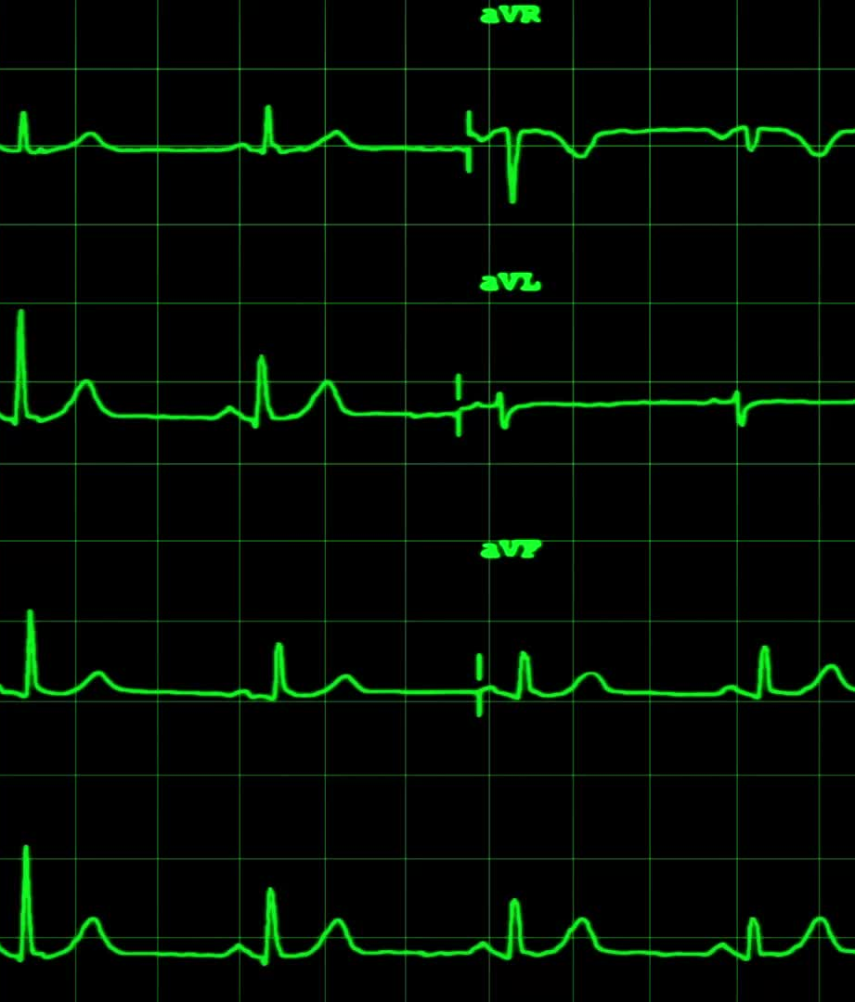
Difference between histogram and bar-chart
A common mistake among beginners is getting confused between histograms and bar charts. Histograms have the response variable on the x-axis, and the y-axis shows the frequency of different values of the response. In contrast, a bar chart has the response variable on the y-axis and a categorical explanatory variable on the x-axis.

Slide 8
Bar Plot or Bar Chart
Bar plot or Bar Chart in R is used to represent the values in data vector as height of the bars. The data vector passed to the function is represented over y-axis of the graph. Bar chart can behave like histogram by using table() function instead of data vector.
Syntax: barplot(data, xlab, ylab)
where:
data is the data vector to be represented on y-axis
xlab is the label given to x-axis
ylab is the label given to y-axis
Note: To know about more optional parameters in barplot() function, use the below command in R console:
help("barplot")

Slide 9
# defining vector
x <- c(7, 15, 23, 12, 44, 56, 32)
# output to be present as PNG file
png(file = "barplot.png")
# plotting vector
barplot(x, xlab = "Geeks Audience", ylab = "Count", col = "white",
col.axis = "darkgreen", col.lab = "darkgreen")
# saving the file
dev.off()

Slide 10
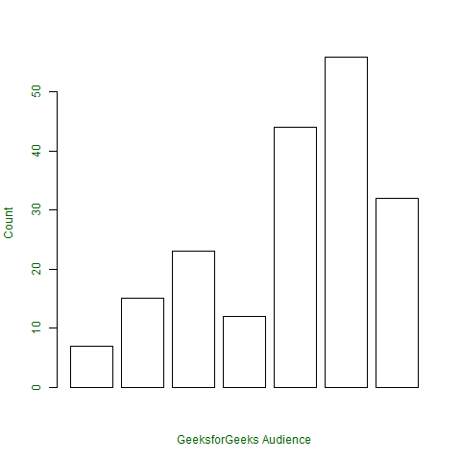

Slide 11
Pie Diagram or Pie Chart
Pie chart is a circular chart divided into different segments according to the ratio of data provided. The total value of the pie is 100 and the segments tell the fraction of the whole pie. It is another method to represent statistical data in graphical form and pie() function is used to perform the same.
Syntax: pie(x, labels, col, main, radius)
where,
x is data vector
labels shows names given to slices
col fills the color in the slices as given parameter
main shows title name of the pie chart
radius indicates radius of the pie chart. It can be between -1 to +1
Note: To know about more optional parameters in pie() function, use the below command in the R console:
help("pie")

Slide 12
# defining vector x with number of articles
x <- c(210, 450, 250, 100, 50, 90)
# defining labels for each value in x
names(x) <- c("Algo", "DS", "Java", "C", "C++", "Python")
# output to be present as PNG file
png(file = "piechart.png")
# creating pie chart
pie(x, labels = names(x), col = "white", main = "Articles on GeeksforGeeks", radius = -1,
col.main = "darkgreen")
# saving the file
dev.off()

Slide 13
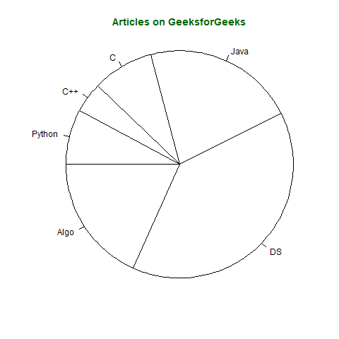

Slide 14
Pie chart – 3D
Pie chart in 3D can also be created in R by using following syntax but requires plotrix library.
Syntax: pie3D(x, labels, radius, main)
Note: To know about more optional parameters in pie3D() function, use below command in R console:
help("pie3D")

Slide 15
# importing library plotrix for pie3D()
library(plotrix)
# defining vector x with number of articles
x <- c(210, 450, 250, 100, 50, 90)
# defining labels for each value in x
names(x) <- c("Algo", "DS", "Java", "C", "C++", "Python")
# output to be present as PNG file
png(file = "piechart3d.png")
# creating pie chart
pie3D(x, labels = names(x), col = "white",
main = "Articles on GeeksforGeeks",
labelcol = "darkgreen", col.main = "darkgreen")
# saving the file
dev.off()

Slide 16
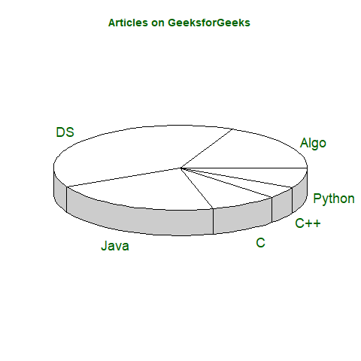

Slide 17
Histogram
Histogram is a graphical representation used to create a graph with bars representing the frequency of grouped data in vector. Histogram is same as bar chart but only difference between them is histogram represents frequency of grouped data rather than data itself.
Syntax: hist(x, col, border, main, xlab, ylab)
where:
x is data vector
col specifies the color of the bars to be filled
border specifies the color of border of bars
main specifies the title name of histogram
xlab specifies the x-axis label
ylab specifies the y-axis label
Note: To know about more optional parameters in hist() function, use below command in R console:
help("hist")

Slide 18
# defining vector
x <- c(21, 23, 56, 90, 20, 7, 94, 12,
57, 76, 69, 45, 34, 32, 49, 55, 57)
# output to be present as PNG file
png(file = "hist.png")
# hist(x, main = "Histogram of Vector x",
xlab = "Values",
col.lab = "darkgreen",
col.main = "darkgreen")
# saving the file
dev.off()

Slide 19
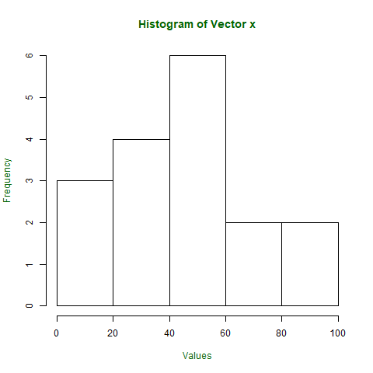

Slide 20
Scatter Plot
A Scatter plot is another type of graphical representation used to plot the points to show relationship between two data vectors. One of the data vectors is represented on x-axis and another on y-axis.
Syntax: plot(x, y, type, xlab, ylab, main)
Where,
x is the data vector represented on x-axis
y is the data vector represented on y-axis
type specifies the type of plot to be drawn. For example, “l” for lines, “p” for points, “s” for stair steps, etc.
xlab specifies the label for x-axis
ylab specifies the label for y-axis
main specifies the title name of the graph
Note: To know about more optional parameters in plot() function, use the below command in R console:
help("plot")

Slide 21
# taking input from dataset Orange already
# present in R
orange <- Orange[, c('age', 'circumference')]
# output to be present as PNG file
png(file = "plot.png")
# plotting
plot(x = orange$age, y = orange$circumference, xlab = "Age",
ylab = "Circumference", main = "Age VS Circumference",
col.lab = "darkgreen", col.main = "darkgreen",
col.axis = "darkgreen")
# saving the file
dev.off()

Slide 22
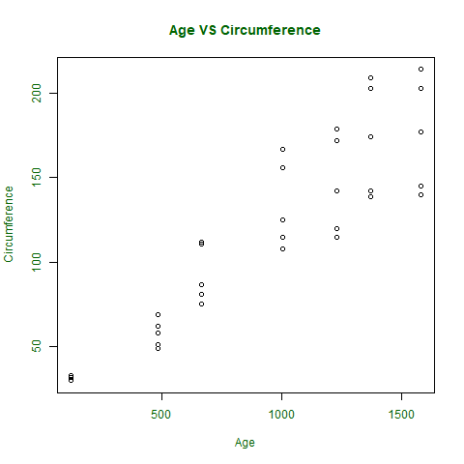

Slide 23
Pairs
If a scatter plot has to be drawn to show the relation between 2 or more vectors or to plot the scatter plot matrix between the vectors, then pairs() function is used to satisfy the criteria.
Syntax: pairs(~formula, data)
where,
~formula is the mathematical formula such as ~a+b+c
data is the dataset form where data is taken in formula
Note: To know about more optional parameters in pairs() function, use the below command in R console:
help("pairs")

Slide 24
# output to be present as PNG file
png(file = "plotmatrix.png")
# plotting scatterplot matrix
# using dataset Orange
pairs(~age + circumference, data = Orange,
col.axis = "darkgreen")
# saving the file
dev.off()

Slide 25
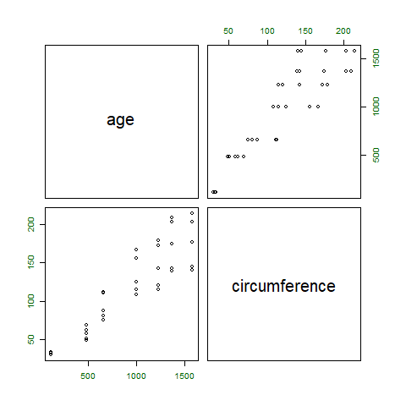

Slide 26
Box Plot
Box plot shows how the data is distributed in the data vector. It represents five values in the graph i.e., minimum, first quartile, second quartile(median), third quartile, the maximum value of the data vector.
Syntax: boxplot(x, xlab, ylab, notch)
where,
x specifies the data vector
xlab specifies the label for x-axis
ylab specifies the label for y-axis
notch, if TRUE then creates notch on both the sides of the box
Note: To know about more optional parameters in boxplot() function, use the below command in R console:
help("boxplot")

Slide 27
# defining vector with ages of employees
x <- c(42, 21, 22, 24, 25, 30, 29, 22,
23, 23, 24, 28, 32, 45, 39, 40)
# output to be present as PNG file
png(file = "boxplot.png")
# plotting
boxplot(x, xlab = "Box Plot", ylab = "Age",
col.axis = "darkgreen", col.lab = "darkgreen")
# saving the file
dev.off()

Slide 28
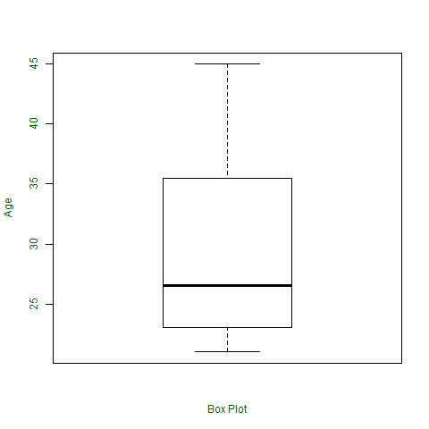

Slide 29
Manipulating the plots in R
Dr. Rakhee Chhibber

Slide 30
R – Pie Charts
R Programming Language uses the function pie() to create pie charts. It takes positive numbers as a vector input.
Syntax: pie(x, labels, radius, main, col, clockwise)
Parameters:
x: This parameter is a vector that contains the numeric values which are used in the pie chart.
labels: This parameter gives the description to the slices in pie chart.
radius: This parameter is used to indicate the radius of the circle of the pie chart.(value between -1 and +1).
main: This parameter is represents title of the pie chart.
clockwise: This parameter contains the logical value which indicates whether the slices are drawn clockwise or in anti clockwise direction.
col: This parameter give colors to the pie in the graph.

Slide 31
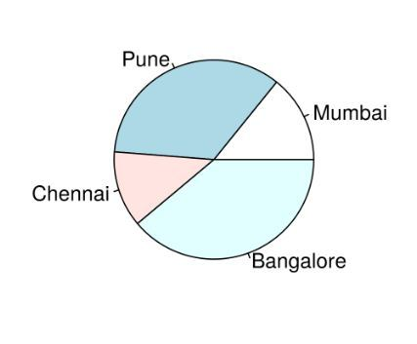
Creating a simple pie chart
To create a simple R pie chart:
By using the above parameters, we can draw a pie chart.
It can be described by giving simple labels.
# Create data for the graph.
geeks<- c(23, 56, 20, 63)
labels <- c("Mumbai", "Pune", "Chennai", "Bangalore")
# Plot the chart.
pie(geeks, labels)

Slide 32
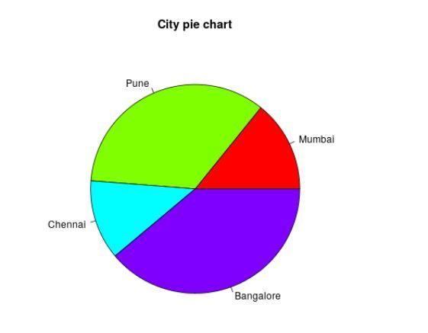
Pie chart including the title and colors
To create a color and title pie chart.
Take all parameters which are required to make a R pie chart by giving a title to the chart and adding labels.
We can add more features by adding more parameters with more colors to the points.
# Create data for the graph.
geeks<- c(23, 56, 20, 63)
labels <- c("Mumbai", "Pune", "Chennai", "Bangalore")
# Plot the chart with title and rainbow
# color pallet.
pie(geeks, labels, main = "City pie chart",
col = rainbow(length(geeks)))

Slide 33
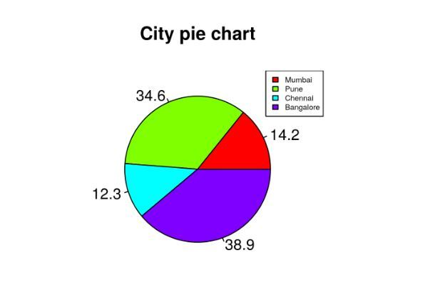
Slice Percentage & Chart Legend
To create chart legend and slice percentage, we can plot by doing the below methods.
There are two more properties of the pie chart:
slice percentage
chart legend.
We can show the chart in the form of percentages as well as add legends.
# Create data for the graph.
geeks <- c(23, 56, 20, 63)
labels <- c("Mumbai", "Pune", "Chennai", "Bangalore")
piepercent<- round(100 * geeks / sum(geeks), 1)
# Plot the chart.
pie(geeks, labels = piepercent, main = "City pie chart", col = rainbow(length(geeks)))
legend("topright", c("Mumbai", "Pune", "Chennai", "Bangalore"),
cex = 0.5, fill = rainbow(length(geeks)))

Slide 34
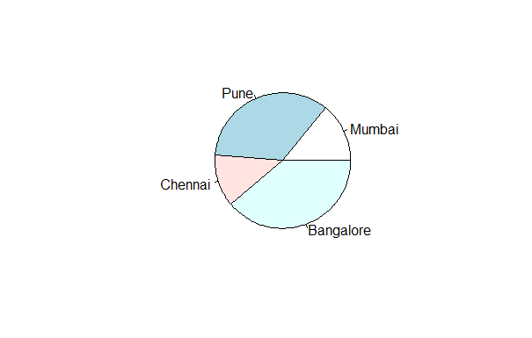
Add pie chart color palettes
With the help of.pal function of the RColorBrewer package in R.
Get the library.
library(RColorBrewer)
# Create data for the graph.
geeks <- c(23, 56, 20, 63)
labelss <- c("Mumbai", "Pune", "Chennai", "Bangalore")
labels<- brewer.pal(length(geeks), "Set2")
pie(geeks, labels = labelss)

Slide 35
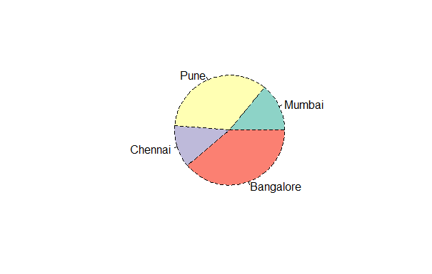
modify the line type of the borders of the plot we can make use of the lty argument:
Get the library.
library(RColorBrewer)
# Create data for the graph.
geeks <- c(23, 56, 20, 63)
labelss <- c("Mumbai", "Pune", "Chennai", "Bangalore")
labels<- brewer.pal(length(geeks), "Set2")
pie(geeks, labels = labelss, col = color, lty = 2)

Slide 36
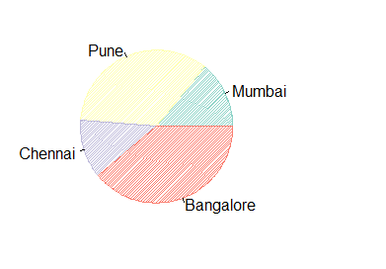
Add shading lines with the density argument.
#Get the library.
library(RColorBrewer)
# Create data for the graph.
geeks <- c(23, 56, 20, 63)
labelss <- c("Mumbai", "Pune", "Chennai", "Bangalore")
labels<- brewer.pal(length(geeks), "Set2")
pie(geeks, labels = labelss,col = color, density = 50, angle = 45)

Slide 37
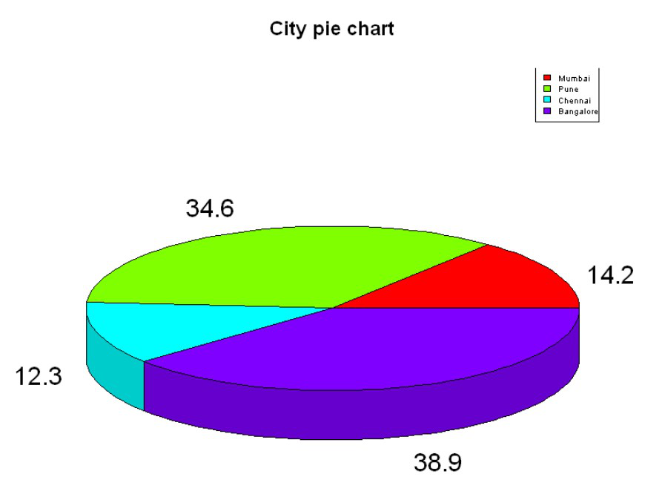
3D Pie Chart
Here we are going to create a 3D Pie chart using plotrix package and then we will use pie3D() function to plot 3D plot.
# Get the library.
library(plotrix)
# Create data for the graph.
geeks <- c(23, 56, 20, 63)
labels <- c("Mumbai", "Pune", "Chennai", "Bangalore")
piepercent<- round(100 * geeks / sum(geeks), 1)
# Plot the chart.
pie3D(geeks, labels = piepercent,
main = "City pie chart", col = rainbow(length(geeks)))
legend("topright", c("Mumbai", "Pune", "Chennai", "Bangalore"), cex = 0.5, fill = rainbow(length(geeks)))

